Slide 1

Class 1
Welcome meeting
2023-2024

Slide 2
Daily routines
Children can come into class from 8:50. They will have morning activities to do until school starts at 9:00 for registration.
Break time is at 10:30.
Lunch time is at 12:00.
The school day ends at 3:30pm.
Please ensure your child has a coat in school every day!

Slide 3
Attendance
It is vital that children arrive at school ready to learn at 9am every morning.
It is disruptive to their learning and others in the class if they are late.
All of our subjects are taught in sequences of learning and missing any part of the carefully structured sequence could lead to gaps in their understanding.

Slide 4
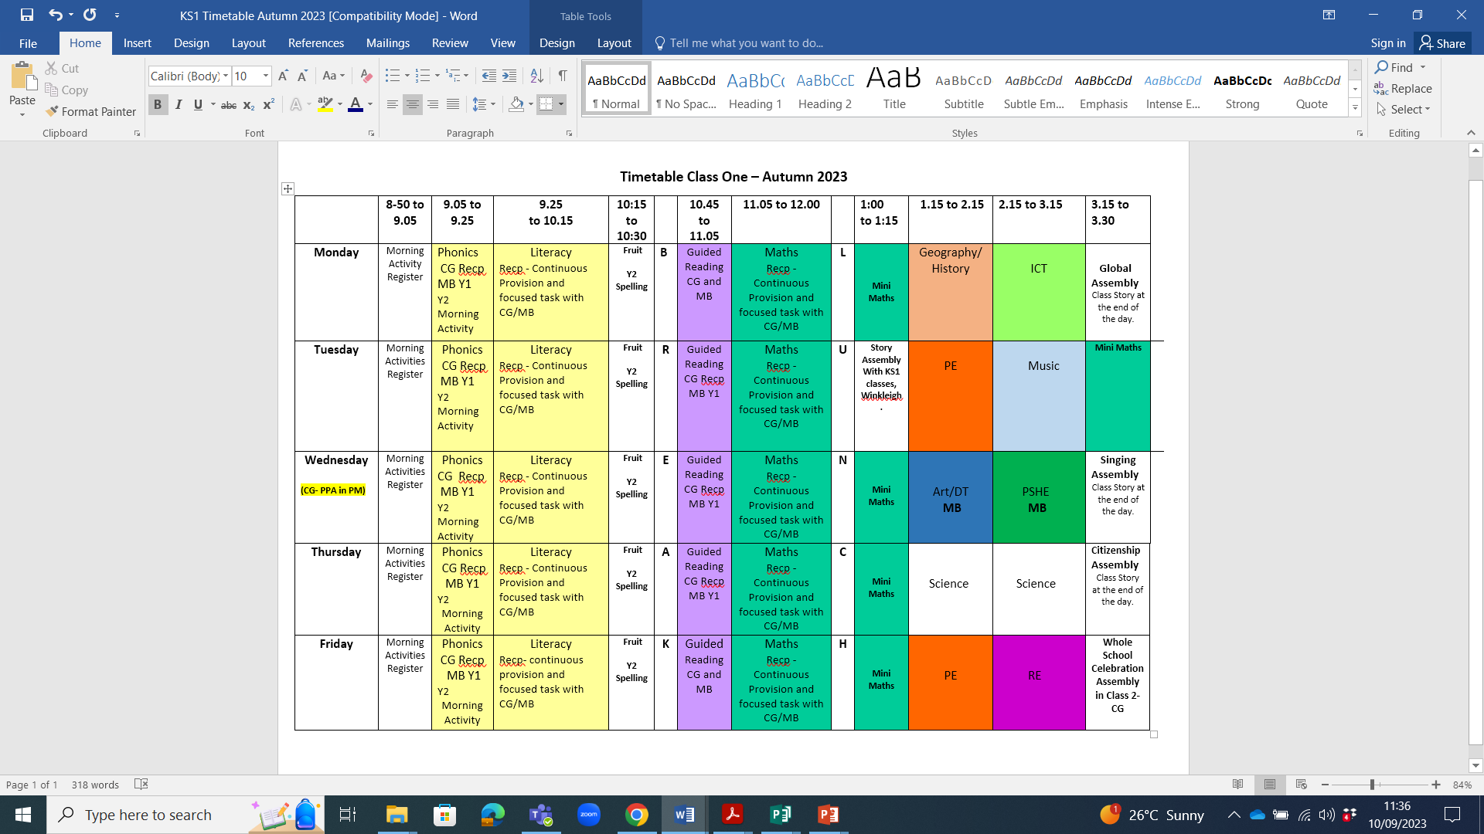

Slide 5
PE
The children will have PE on Tuesday and Friday afternoons.
Please can they wear full PE kit on these days: school hoodie/sweatshirt, plain navy or black shorts/joggers, a plain white t-shirt and black trainers.
PE hoodies are only to be worn on these PE days and not as part of our full school uniform.

Slide 6
Cooperative Learning
The children will be experiencing their learning in groups.
These groups are carefully considered.
One of the ideas behind this strategy is to teach children to collaborate, negotiate and succeed whilst working with any of their classmates.
Due to the nature of cooperative learning, these relationships can take time to establish and, as a school, we do not change these groups.
We often find that the most effective collaborative partnerships occur when children are not in the same social circles!
With reference to children’s relationships, it is normal for children to fall out with their peers – and then to make up. This is an essential part of growing up and being part of a community.

Slide 7
Home learning
Spelling
Weekly emails will be sent home with the spellings or phonics words the children are learning in that week. These won’t be formally tested in school, but we hope to see the children using them within their independent writing.
Reading The expectation is that all children read daily.
It is important to remember that just because a book has been read once, it can be looked at/read/discussed again. This helps children to fully understand the text as well as develop good comprehension skills.
Please record any time you read with your child in their Reading Record Book.
Other home leaning activities may be sent home during the term. These will be related to the children’s learning and it would be great if you could help your child to complete these and return them by the date given.

Slide 8
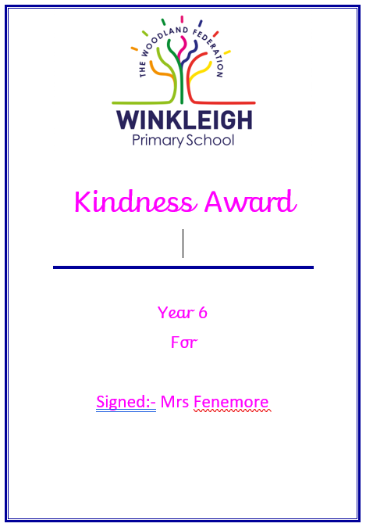
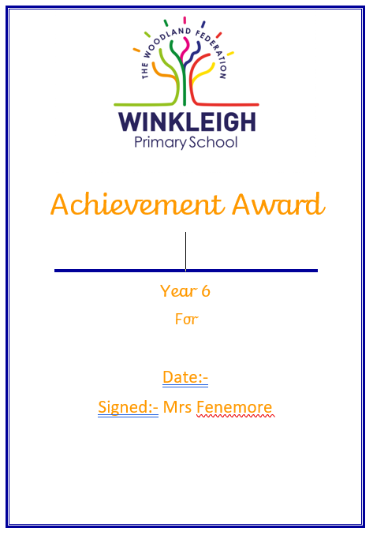

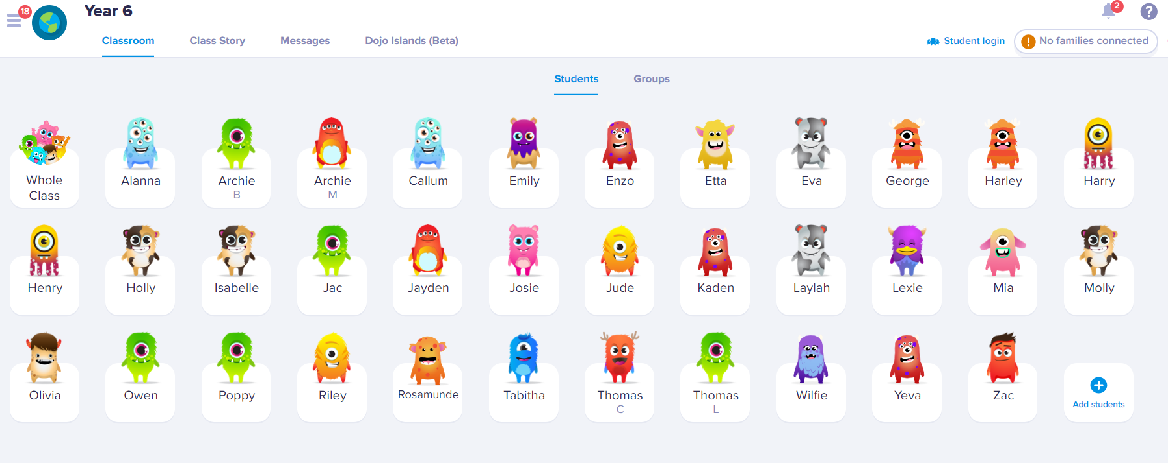
Celebrating learning

Slide 9
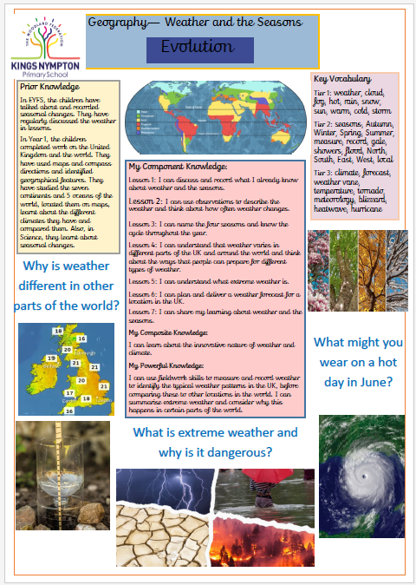
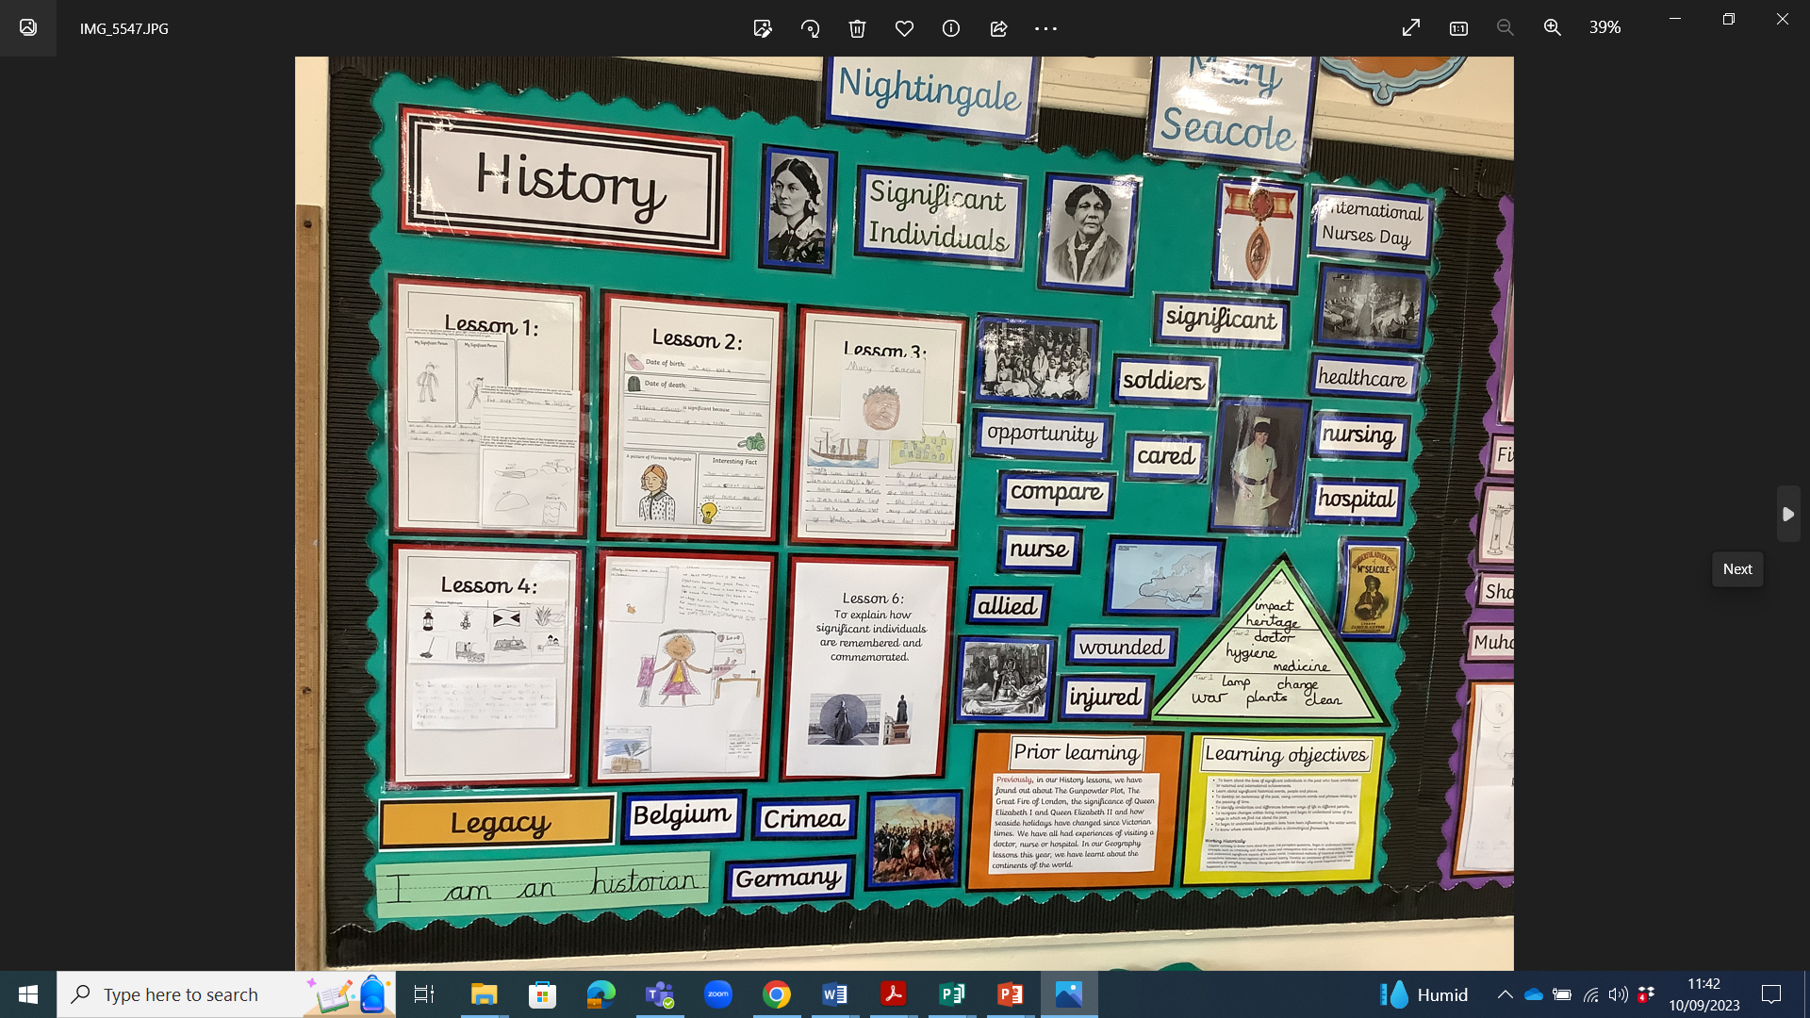
Displays and cover sheets
https://www.kingsnympton.devon.sch.uk/kingsnympton/school-life/our-classes/class-1

Slide 10
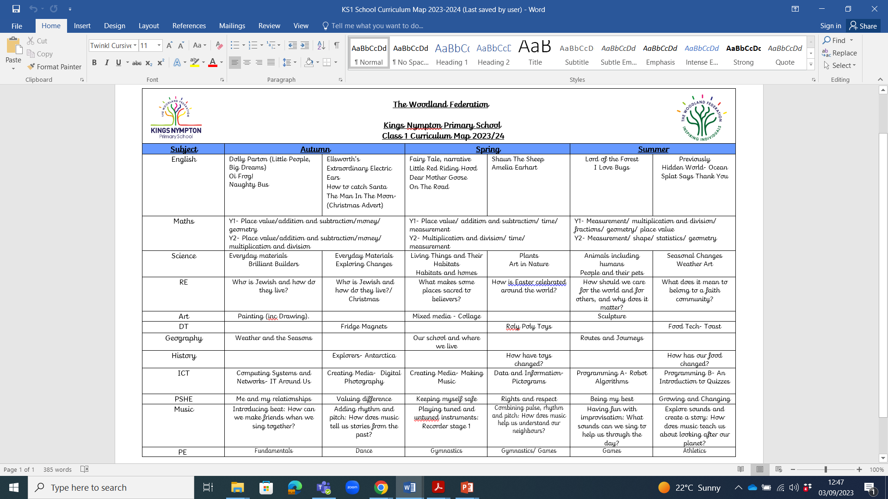
Curriculum map
https://www.winkleigh.devon.sch.uk/page/?title=Our+Curriculum+in+Detail&pid=191

Slide 11
Trips
Autumn term
This term we will be visiting Bear Town in Cullompton.
Spring term
This term we will be visiting Northam Burrows.
Summer term
This term we will be visiting Crooklets Beach.
We are planning as many trips as possible for this year, but there are no additional funds to support these, so we do rely on parent’s support. Please ensure you return consent forms as quickly as possible. If you have any worries about these trips, please email admin and we will do all we can to help you.
As well as these trips, we look forward to experiencing other events and workshops throughout the year.

Slide 12
Communication
If you have any questions about anything regarding your child, please do not hesitate to contact myself as the class teacher.
Please email admin@kingsnympton.devon.sch.uk .We will always try to get a reply to you within 48 hours.
As a school, we take allegations of bullying very seriously. Should you have a concern regarding this, speak to me straight away and a full investigation will be carried out.

Slide 13
Online Safety
After reading the government’s most recent Keeping Children Safe in Education document, alongside our training and experiences nationally,, we would ask you to be extra vigilant with your children’s online activities at home.
We have received extra guidance regarding how we filter and monitor children’s internet usage whilst in school from the government.
Online safety will continue to be taught as part of the ICT curriculum each term.

Slide 14
Any questions?

