Slide 1

Year Six
Welcome meeting
2023-2024

Slide 2
Daily routines
School gate is open from 8:45 to 8:55
Children will have a rota of responsibilities to carry out in the mornings before registration.
Morning task when children get into the classroom
Break time at 10:30
Lunch time at 12:00
End of day: all children will leave school at 3:30pm except for those on the bus

Slide 3
Attendance
It is vital that children arrive at school ready to learn at 9am every morning.
It is disruptive to their learning and others in the class if they are late.
All of our subjects are taught in sequences of learning and missing any part of the carefully structured sequence could lead to gaps in their understanding.

Slide 4
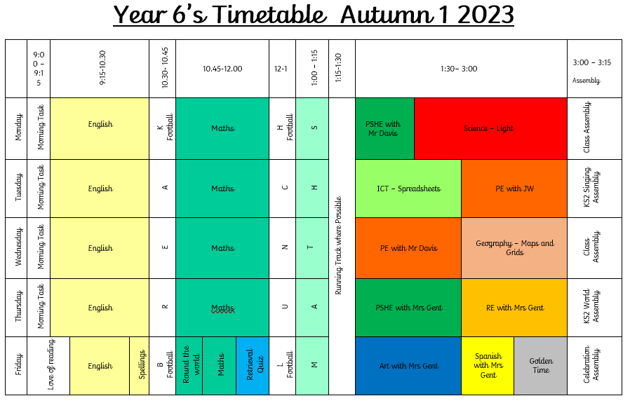

Slide 5
PE
The children will have PE on Tuesday and Wednesday afternoons.
Please can they wear full PE kit on these days: navy blue or plain black hoodie/sweatshirt, plain navy or black shorts/joggers, a plain white t-shirt and black trainers.
PE hoodies are only to be worn on these PE days as not as part of our full school uniform.

Slide 6
Cooperative Learning
The children will be experiencing their learning in groups of four.
These groups are carefully considered and will be the same for an entire half term. This means that they will be part of six ‘teams’ during this year.
One of the ideas behind this strategy is to teach children to collaborate, negotiate and succeed whilst working with any of their classmates.
Due to the nature of cooperative learning, these relationships can take time to establish and, as a school, we do not change these groups.
We often find that the most effective collaborative partnerships occur when children are not in the same social circles!
With reference to children’s relationships, it is normal for children to fall out with their peers – and then to make up. This is an essential part of growing up and being part of a community.

Slide 7
Home learning
Spelling
Weekly spellings will be tested every Friday and will be sent home via email.
Reading
The expectation is that Year 6 children are reading at least four times as week.
Times tables
Every Friday, the class will take part in the Around the World challenge.

Slide 8

Times tables rock stars
Times tables will be updated along with the Around the World challenge.
Opportunities for children to challenge each other – the aim is to promote enjoyment for learning times tables.

Slide 9

Read theory
Opportunity to practice reading comprehension.
We will be encouraging children to answer questions carefully!

Slide 10

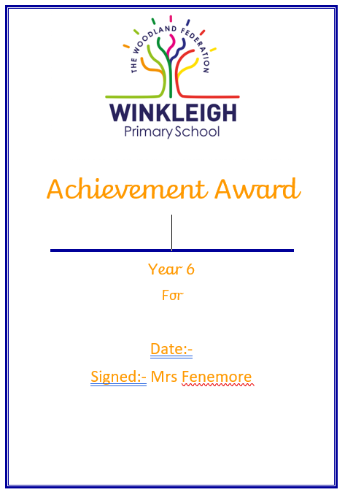

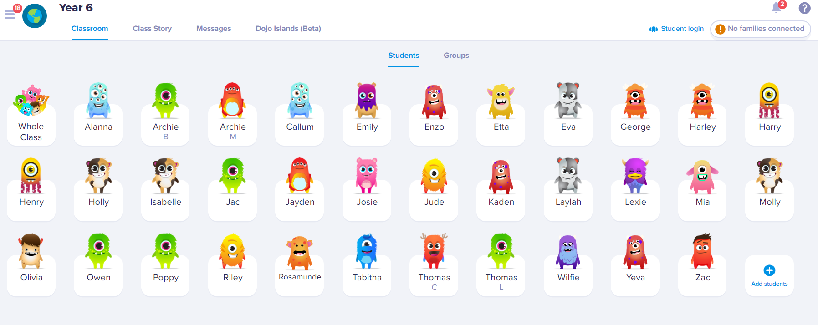
Celebrating learning

Slide 11
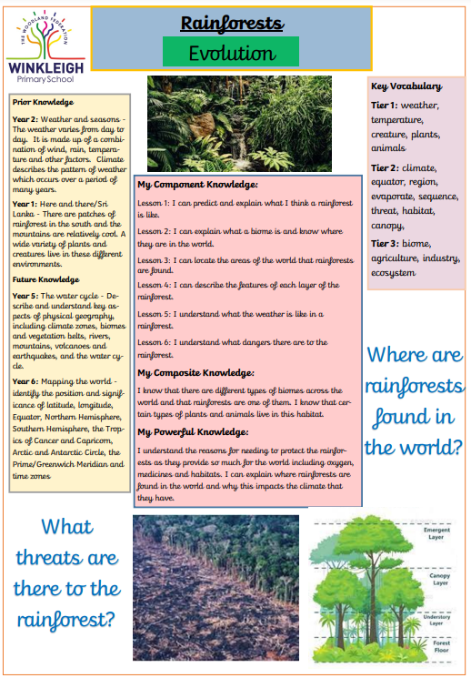
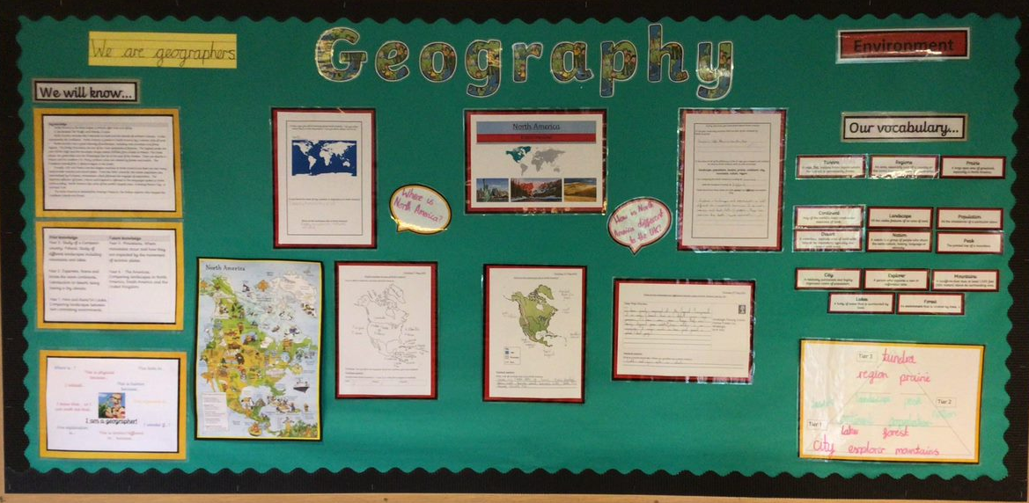
Displays and cover sheets
https://www.winkleigh.devon.sch.uk/school-life/class-structure/year-4

Slide 12
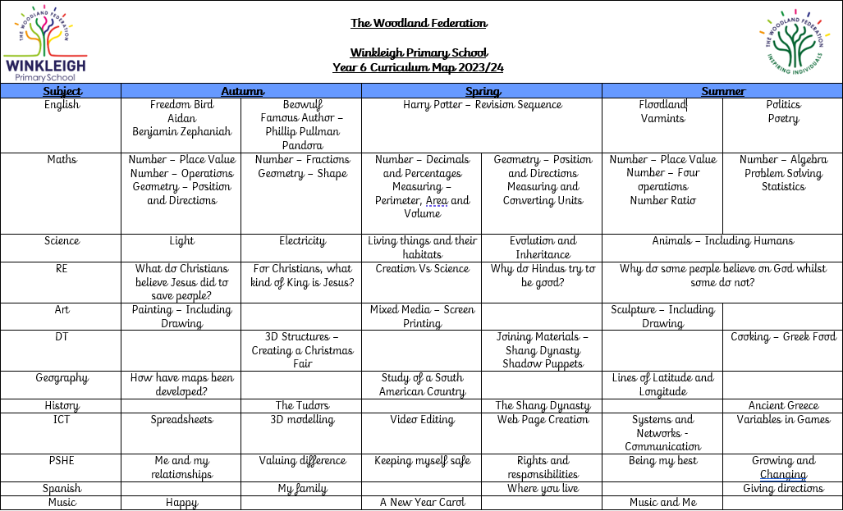
Curriculum map
https://www.winkleigh.devon.sch.uk/page/?title=Our+Curriculum+in+Detail&pid=191

Slide 13
Trips
Autumn term
This term we will be visiting Ultimate Adventure in Bideford
Summer term
The children will have two residentials – London and Surfing!
As well as these trips, we look forward to being invited to some sports activities and fixtures throughout the year..

Slide 14
SATs
In May, the children will sit their Key Stage 2 SATs.
These consist of: 3 x mathematics papers, 2 x spelling and grammar papers and 1 x reading paper.
They will also have their writing assessed throughout the year.
  k

Slide 15
Communication
If you have any questions about anything regarding your child, please do not hesitate to contact myself as the class teacher.
Please email admin@winkleigh.devon.sch.uk .We will always try to get a reply to you within 48 hours.
As a school, we take allegations of bullying very seriously. Should you have a concern regarding this, speak to me straight away and a full investigation will be carried out.

Slide 16
Online Safety
After reading the government’s most recent Keeping Children Safe in Education document, alongside our training and experiences nationally,, we would ask you to be extra vigilant with your children’s online activities at home.
We have received extra guidance regarding how we filter and monitor children’s internet usage whilst in school from the government.
Online safety will continue to be taught as part of the ICT curriculum each term.

Slide 17
Any questions?

